Slide 1
DX University
Bryce Canyon, UT – 2012

Slide 2
How to Build a DXing Station - Antennas
Mike Fulcher KC7V

Slide 3
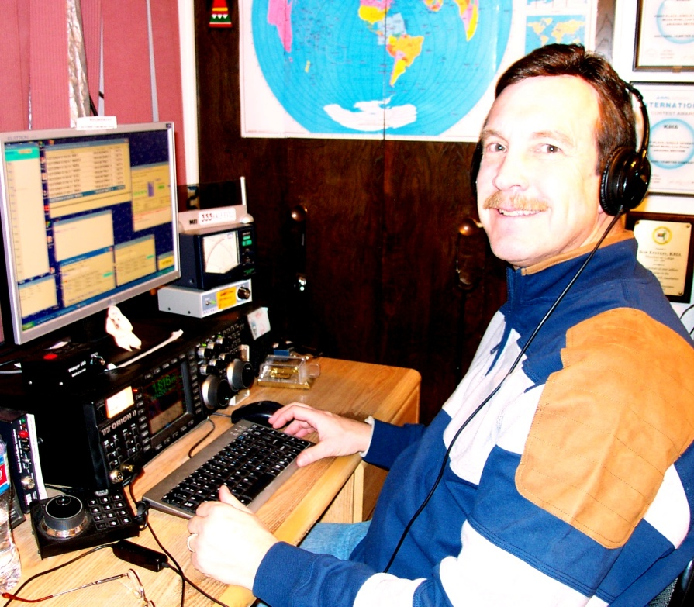
Mike Fulcher KC7V
First licensed in 1972 as WN9IXO. Has held many interesting calls and operated from 36 entities and 21 Zones.
Founding member of the VooDoo Contest Group. Member of FOC. Member and past President of CADXA. Founding member of the Arizona Outlaws Contesting Club.
Referee at WRTC in 1996 and 2006.

Slide 4
How to Build a DXing Station - Antennas
Start with the end in mind
Plot out on paper
Budget Concerns
What are you able to do physically?
Put as much investment in antennas as you can!
It’s a challenge and a lot of fun!

Slide 5
How to Build a DXing Station – Antennas
Requirements related to effective DXing
Pattern matching propagation path to DX
Pattern reducing effects of interference
Efficiency
General characteristics
Efficient antennas are likely to be narrowband
Antennas are the best investment in your station
Reliability can be more important than performance
Higher antennas work DX better than lower ones

Slide 6
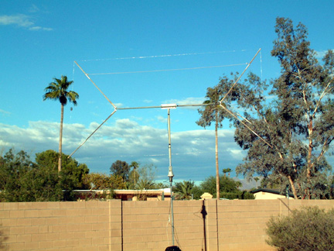
How to Build a DXing Station – Antennas
Low frequencies antennas (160 & 80 m)
Transmit antennas
Verticals
Dipoles (as high as possible)
Receive antennas
Beverages
Loops (ground-dependent antennas)
Flag/pennants (ground-independent antennas)
4-square short verticals

Slide 7
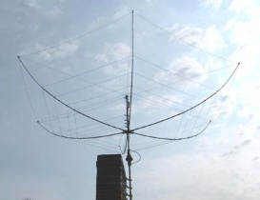
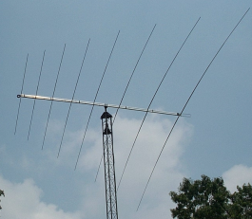
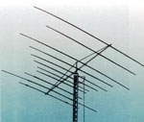
How to Build a DXing Station – Antennas
Antennas - HF
Monoband antennas
Full size: Yagi¹
Shortened: Moxon²
Multi-band antennas
Fixed
Hexbeam¹ Quad⁴
Spider beam² Multiband yagi⁵
Log periodic³
Adjustable
StepIR
1
2
1
2
3
4
5

Slide 8
How to Build a DXing Station - Antennas
Low Budget
Wire, even very small diameter
Dipoles, single band or fan
Vertical, used market
Portable antennas
HOA? – attic antenna, paint and fake ivy
Be creative, you will work stations

Slide 9
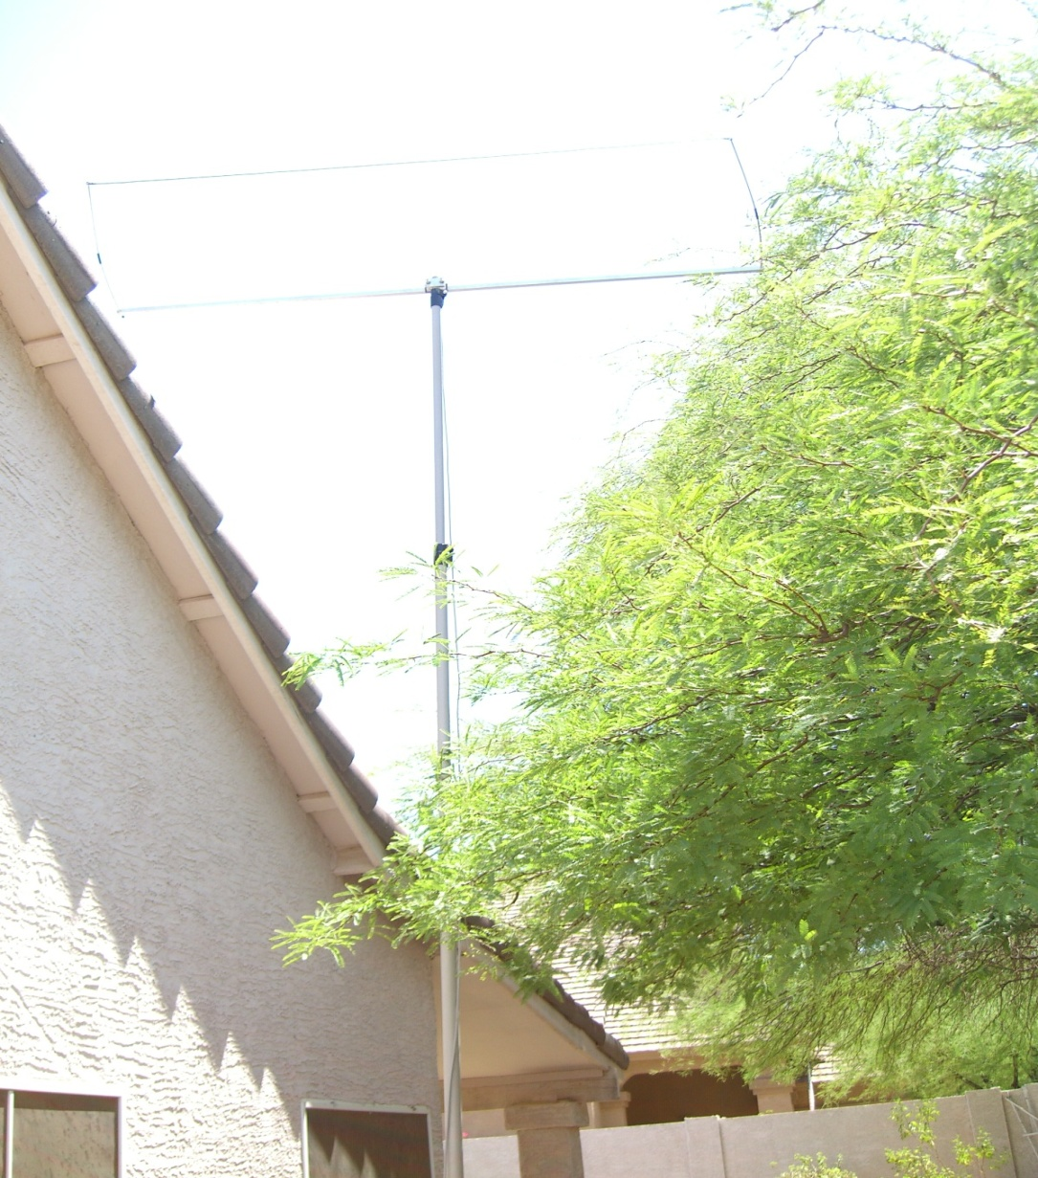
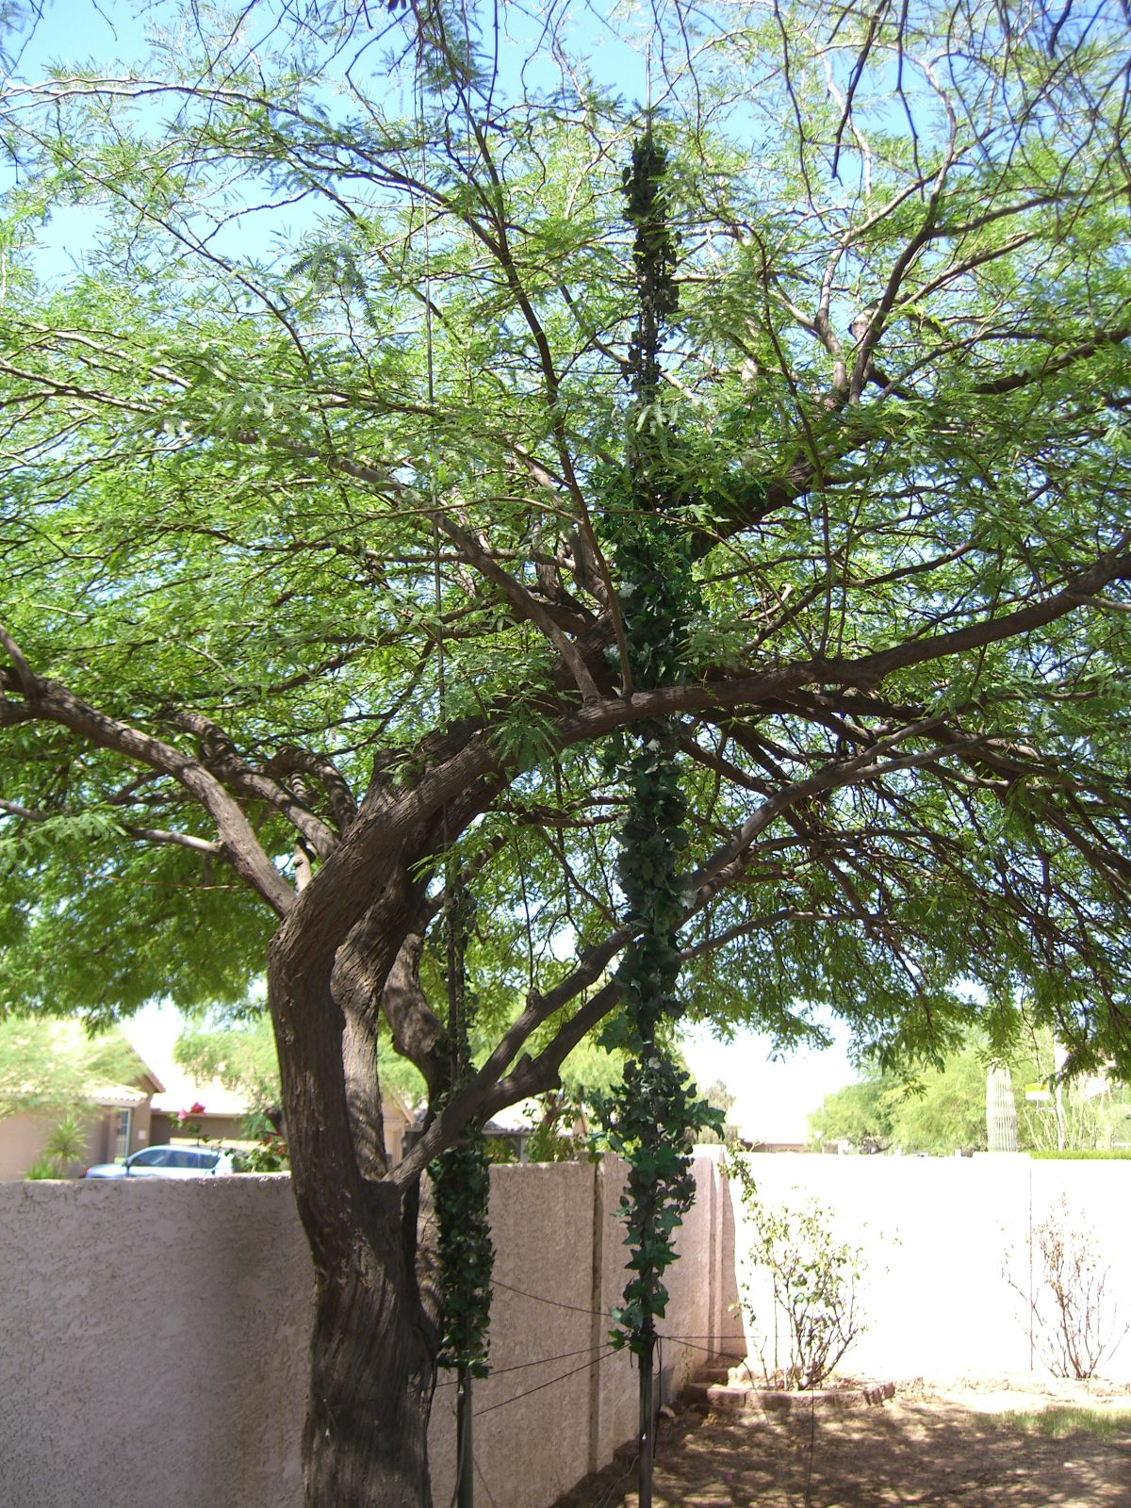
How to Build a DXing Station - Antennas
Low Budget

Slide 10
How to Build a DXing Station - Antennas
Medium Budget
Tower
Crank up or Guyed
Tribander, Smaller Monobanders
Preferably 50 to 70 feet
Wires for low bands

Slide 11
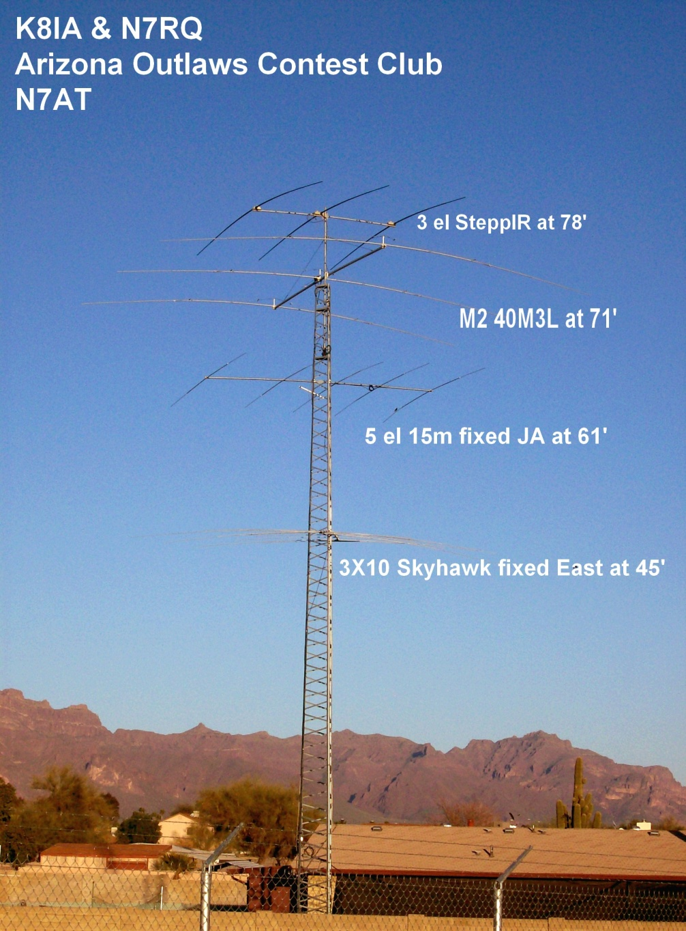
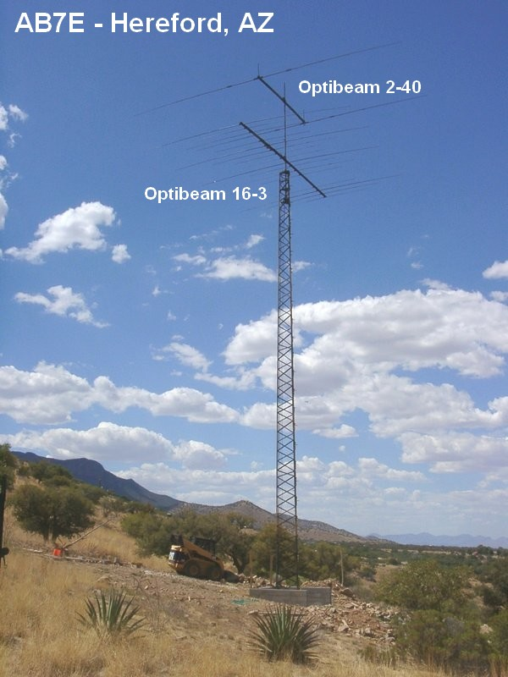
How to Build a DXing Station - Antennas
Medium Budget

Slide 12
How to Build a DXing Station - Antennas
Mega Budget
Multiple Tall Towers
Big Monobanders
Fixed Yagis in key directions
Stacked yagis for gain and elevation fills
Preferably 100 to 200 feet
Monobanders for 40m and even 80m

Slide 13
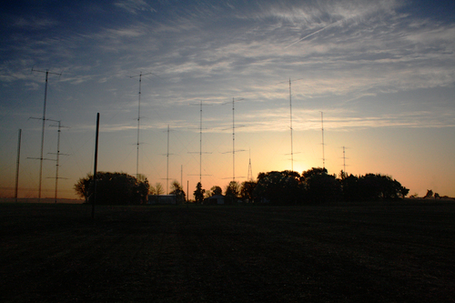
How to Build a DXing Station - Antennas
Big Gun USA…N0NI

Slide 14
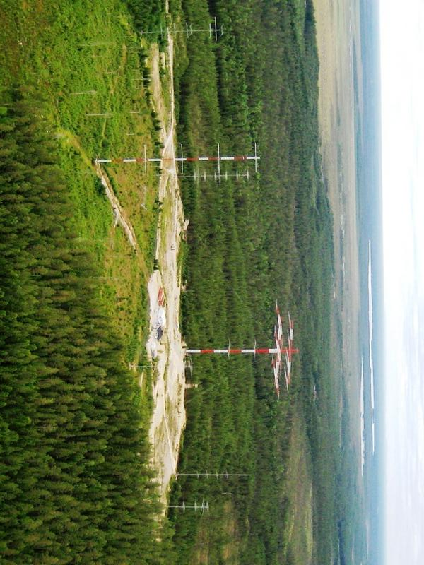
How to Build a DXing Station - Antennas
Big Gun..OH8X etc

Slide 15
How to Build a DXing Station - Antennas
Take advantage of tools available
HFTA – High Frequency Terrain Analysis – ARRL Antenna Handbook
Low Band DXing
Grayline Maps
Study Arrival Angles
Antenna modeling tools like EZNEC

Slide 16
How to Build a DXing Station - Antennas
Resonant antennas better
You can get many things to work with tuners
Creativity gets you on the air
Plan ahead and get help
Make noise on the bands

Slide 17
How to Build a DXing Station - Antennas
Loud is Good
Louder is Better!!

